Slide 1

Tlock
Presented by:
Ahmed Omar Saad
&
Under the supervision of:
Ms. Naira El-Sayed Abdellatif

Slide 2
CONTENT
01
What is Tlock?
02
What is the features of Tlock?
03
How to use Tlock?
04
Acknowledgements.

Slide 3
01
What is Tlock?
T-lock is a project that encrypts text with 48 layers of encryption and it can encrypt text and decrypt it. It is written in Python. It can also encrypt and decrypt voice, text, video, images and Python code.

Slide 4
02
What are the features of Tlock?
You can run it without installation
It can encrypt and decrypt text and Python code by 48 layers of encrytion
It can encrypt and decrypt video, audio and images by 12 layers of encrytion
Easy to use
Note: It can use a lot of recources and images is encrypted by one layer.

Slide 5
How to use Tlock?
(Save Tlock text file): To create a tlock encrypted text file (*.tetf).
(Open Tlock text file): To open a tlock encrypted text file (*.tetf).
(Create a Teif): To encrypt an image and save the encrypted image in Tlock Encrypted Image file (*.teif) extention
(Open a Teif): To decrypt an image and save the decrypted image in Tlock Encrypted Image file (*.teif) extention
(Create a Teaf): To encrypt an audio and save the encrypted image in Tlock Encrypted Audio file (*.teaf) extention
(Open a Teaf): To decrypt an audio and save the decrypted image
03

Slide 6
7. (Create a Tevf): To encrypt an image and save the encrypted image in Tlock Encrypted Image file (*.teif) extention
8. (Open a Tevf): To decrypt an image and save the decrypted image in Tlock Encrypted Image file (*.teif) extention
9. (Python IDE): To use Python encryption supported IDE and it can save, run and open Tlock Python Files (*tpy)
03

Slide 7
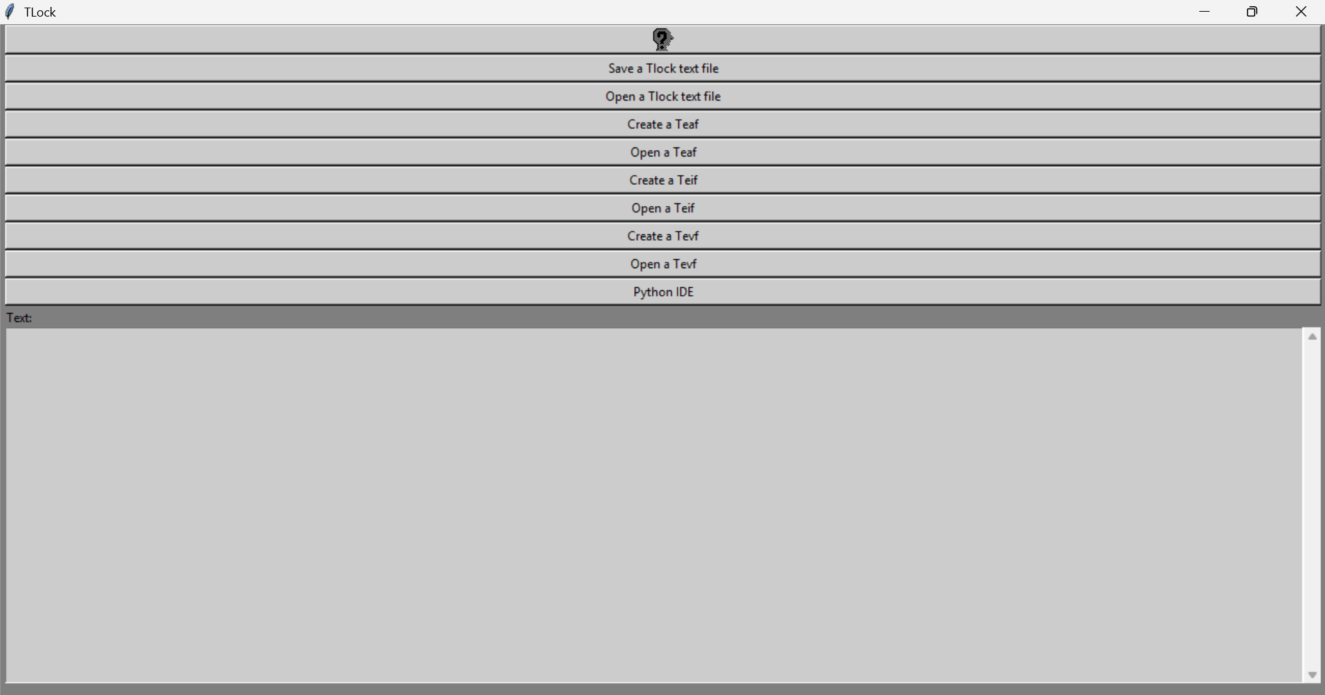

Slide 8
04
Acknowledgements
I would like to express my deepest appreciation to my ICT teacher :
Naira Sayed for supporting me.

Slide 9
Thanks for listening!
Presented by:
Ahmed Omar Saad
&
Under the supervision of:
Ms. Naira Sayed

